Slide 1
JavaScript for Web Warriors, 7e Chapter 7: Manipulating Data in Strings, Arrays, and Other Objects

Slide 2
Chapter Objectives (1 of 2)
By the end of this chapter, you should be able to:
Read information from a text file.
Read and write content into a text string.
Interpret the language of regular expressions.
Create a regular expression object and use it in a program.
Notes:
Instructions: Briefly review with students the major concepts you will be covering during this class. There is one objective for every major A-head section of the chapter.

Slide 3
Chapter Objectives (2 of 2)
By the end of this chapter, you should be able to:
Sort an array using the sort() method with a compare function.
Work with the properties and methods of the Math object.
Work with the properties and methods of the Date object.
Explore text strings using template literals.
Notes:
Instructions: Briefly review with students the major concepts you will be covering during this class. There is one objective for every major A-head section of the chapter.

Slide 4
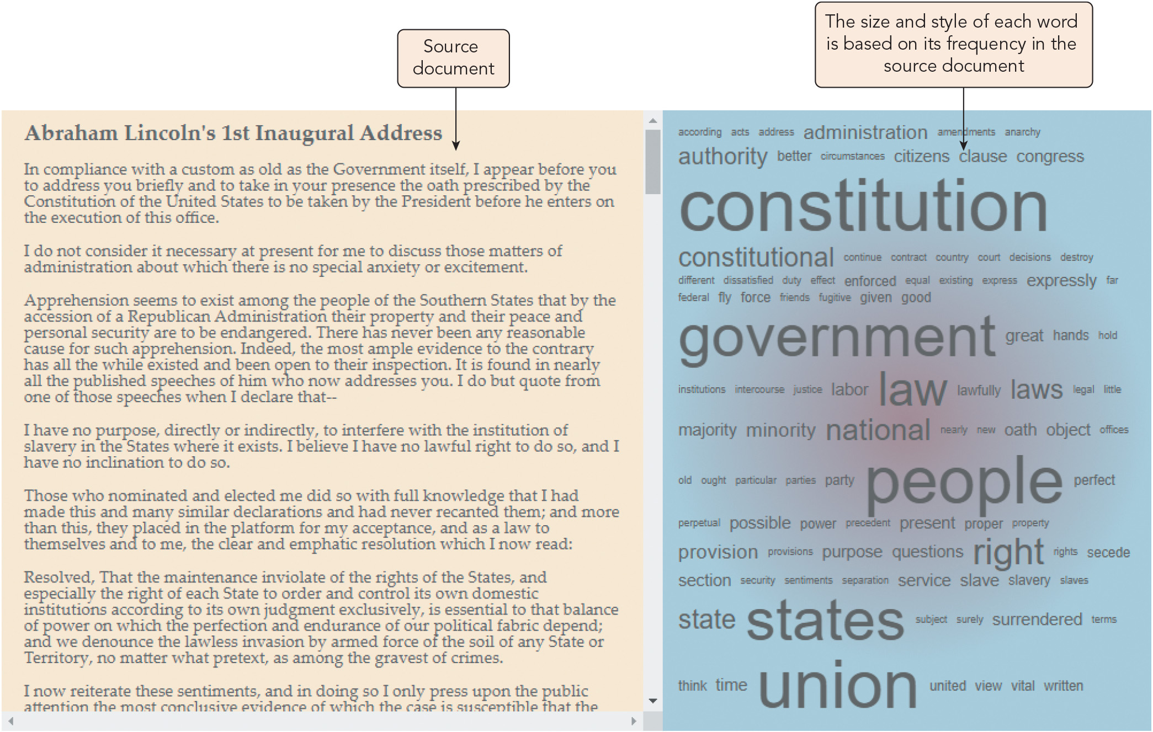
Retrieving Content from a Text File (1 of 4)
Figure 7-1 A sample word cloud

Slide 5
Retrieving Content from a Text File (2 of 4)
The file object
Files that users select with a file input control are accessed using the File API
Input boxes of the file data type support the files collection of file objects: element.files()
The File Reader API
Provided to read the contents of an external file
Syntax for the FileReader() object constructor: let reader = new FileReader()
FileReader object works asynchronously while rest of the script continues to run
Triggers the following events: loadstart, progress, load (reading completed with no errors), abort, error, loadend (reading completed, with or without an error)
Use the textContent property to strip the HTML tags from a text string
A file is an example of a Blob (Binary Large Object): data stored as a chunk of bytes

Slide 6
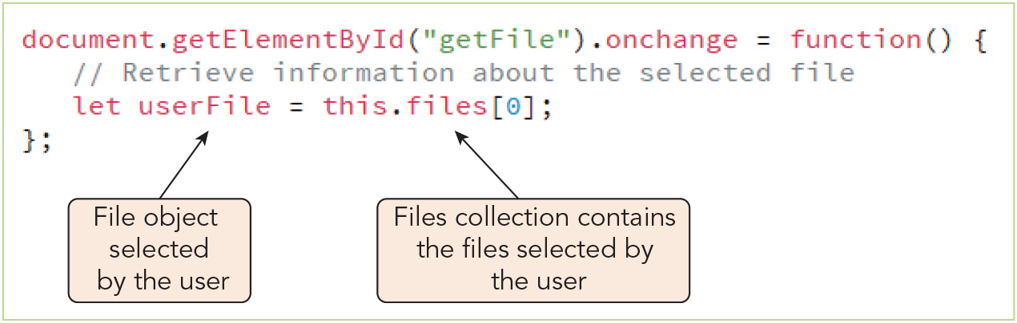
Retrieving Content from a Text File (3 of 4)
Figure 7-3 Retrieving a selected file

Slide 7
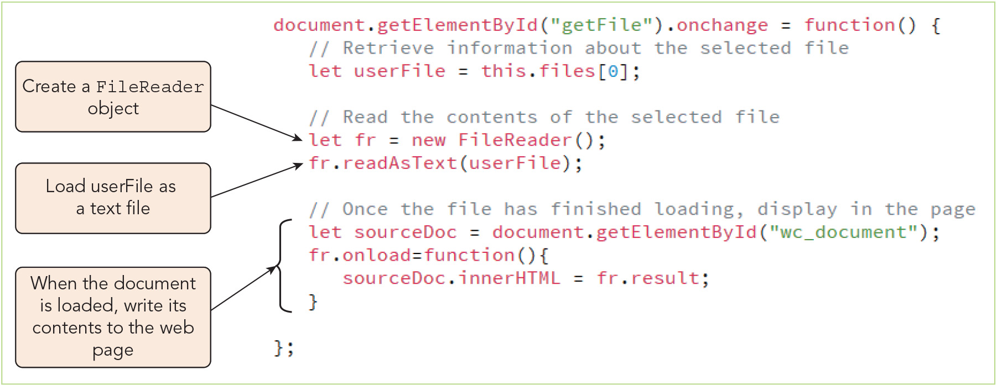
Retrieving Content from a Text File (4 of 4)
Figure 7-5 Reading and loading the contents of a text file

Slide 8
Working with Text Strings (1 of 8)
Syntax for object constructor: let string = new String(text);
Searching for substrings within a text string
The startsWith(), endsWith(), and includes() methods indicate whether a text string contains a specified substring (group of characters)
Whitespace character: any blank or nonprintable character (e.g., space, tab, line break)
The indexOf() and lastIndexOf() methods return the index of the first and last occurrence of a substring
Examples: "First Inaugural Address".indexOf(" "); // returns 5 "First Inaugural Address".lastIndexOf(" "); // returns 15
Both return -1 if the substring is not found in the larger string
The type property of the file object returns the file's MIME type

Slide 9
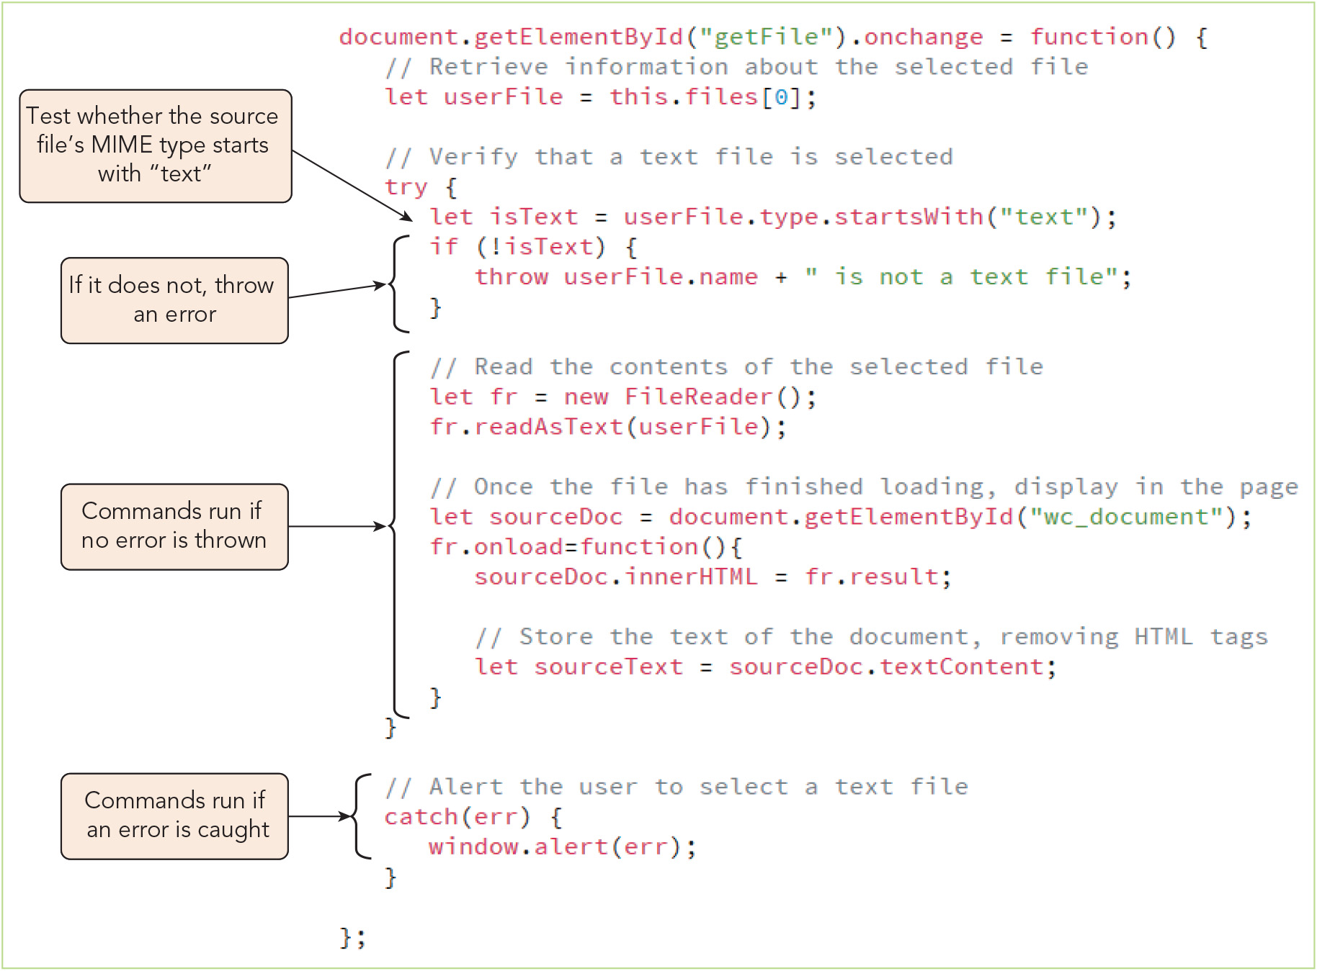
Working with Text Strings (2 of 8)
Figure 7-9 Verifying that the user selects a text file

Slide 10
Working with Text Strings (3 of 8)
Modifying text strings
Text strings are immutable
Method | Description
string.toLowerCase() | Converts string to lowercase characters
string.toLocaleLowerCase(locale) | Converts string to lowercase characters based on the user’s locale
string.toUpperCase() | Converts string to uppercase characters
string.toLocaleUpperCase(locale) | Converts string to uppercase characters based on the user’s locale
string.trim() | Removes whitespace characters from the start and end of string

Slide 11
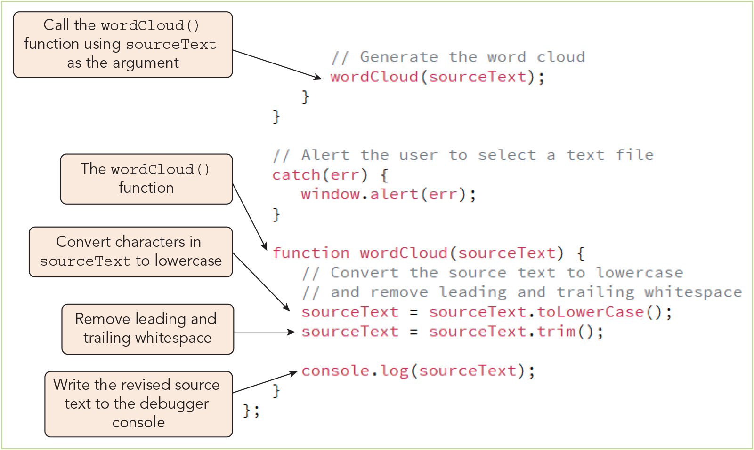
Working with Text Strings (4 of 8)
Figure 7-11 Modifying the source text

Slide 12
Working with Text Strings (5 of 8)
Extracting characters and substrings
Sample expression to extract a single character using the charAt() method: "Abraham Lincoln".charAt(4) // returns "h"
Extract longer substrings using the slice(), substr(), and substring() methods
All accept: first argument specifying where extraction begins and second (optional) argument specifying where the extraction ends
Second argument refers to index of the character after the end of the extraction for the slice() and substring() methods
Second argument refers to the number of characters to extract for the substr() method
With one argument, all three extract to the end of the string

Slide 13
Working with Text Strings (6 of 8)
Extracting characters and substrings (continued)
Sample expressions using the slice(), substr(), and substring() methods: "Abraham Lincoln".slice(4,10) // "ham Li" "Abraham Lincoln".substring(4,10) // "ham Li" "Abraham Lincoln".substr(4,10) // "ham Licoln"
When the first argument is negative, the slice() and substr() methods extract substrings counting backwards from the end of the string, but substring() method treats it as a 0 index, e.g.: "Abraham Lincoln".slice(-7, -3) // "Linc" "Abraham Lincoln".substring(-7) // "Abraham Lincoln" "Abraham Lincoln".substr(-7, 4) // "Linc"

Slide 14
Working with Text Strings (7 of 8)
Extracting characters and substrings (continued)
Extraction is often used in conjunction with the indexOf() and lastIndexOf() methods, e.g.: let email = "lincoln@example.com"; let atIndex = email.indexOf("@"); // returns 7 email.slice(0, atIndex); // returns "lincoln email.slice(atIndex + 1); // returns "example.com"
Alternatively, use the split() method to return an array of substrings, passing in a delimiter character to mark where the text should be split, e.g.: let email = "lincoln@example.com"; let parts = email.split("@"); // parts[0] = "lincoln" // parts[1] = "example.com"

Slide 15
Working with Text Strings (8 of 8)
Combining text strings
The concat() method appends one or more text strings to an existing string, but there is no reason to use it in preference to the + and += operators
Comparing text strings
The comparison operator === tests whether two strings are identical in content and type
The < and > operators compare text strings based on lexicographical order
Uppercase letters come before lowercase because of their Unicode values
Syntax for the comparing based on the lexicographical order of a specific locale: string1.localeCompare(string2, locale, {options})
locale defines the locale; options provides optional parameters for ordering
Returns -1 or a negative number if string1 comes first, a zero if string1 equals string2, or 1 or a positive number if string2 comes first

Slide 16
Introducing Regular Expressions (1 of 7)
General syntax for regular expressions: /pattern/
Matching a substring
Sample simple regular expression (matches the substring "the"): /the/
Samples using anchors: /^land/ (matches "land" only at the beginning of a text string) /land$/ (matches "land" only at the end of a text string) /^land$/ (matches only text strings containing "land" and nothing else)
Setting regular expression flags
By default, pattern matching is case sensitive and stops with the first match
Flag: a modifier character placed at the end of a regular expression
Adding the g flag finds all matching instances: /pattern/g
Adding the i flag makes the pattern matching case insensitive: /pattern/i
Flags can be combined in any order: /pattern/ig or /pattern/gi

Slide 17
Introducing Regular Expressions (2 of 7)
Defining character types and character classes
Four charter character types: alphabetical characters, digits, word characters (alphabetical characters, digits, or underscores), and whitespace characters (blank spaces, tabs, and new lines)
In regular expressions, a word refers to any substring containing only word characters
Word boundaries (non-word characters) are indicated by the \b symbol
E.g., /\bart/ matches words that begin with "art" such as "article" or "artist"
Digits are represented by the \d symbol
E.g., /\d\d\d\d\d/ matches a substring consisting of 5 consecutive digits
Sample regular expressions combining symbols: /\b\d\d\d\d\d\b/ matches words consisting of exactly 5 digits /^\d\d\d\d\d$/ matches entire text strings that contain only a 5-digit number

Slide 18
Introducing Regular Expressions (3 of 7)
Character | Description
\b | A word boundary
\B | Not a word boundary
\d | A digit from 0 to 9
\D | Any non-digit character
\w | An alphabetical character (in upper- or lowercase letters), a digit, or an underscore
\W | Any non-word character
\s | A whitespace character (a blank space, tab, new line, carriage return, or form feed)
\S | Any non-whitespace character
. | Any character

Slide 19
Introducing Regular Expressions (4 of 7)
Defining character types and character classes (continued)
A character class limits all/part of a regular expression to a select group of characters
Pattern | Description
[chars] | Match any character in the chars list
[^chars] | Do not match any character in the chars list
[char1-charN] | Match characters in the range char1 through charN
[^char1-charN] | Do not match any characters in the range char1 through charN
[a-z] | Match any lowercase letter
[A-Z] | Match any uppercase letter
[a-zA-Z] | Match any lower- or uppercase letter
[0-9] | Match any digit
[0-9a-zA-Z] | Match any digit or letter

Slide 20
Introducing Regular Expressions (5 of 7)
Defining character types and character classes (continued)
Sample regular expression using a character class prefaced with ^ to match all characters that are not vowels: /[^aeiou]/gi
Specifying repeating characters
General syntax, where n is the number of repetitions of the preceding character, character class, or group: {n}
Alternatively, use * for 0 or more repetitions, + for 1 or more repetitions, or ? for 0 or 1 occurrence
To repeat at least n times, use {n,}
To repeat at least n times but no more than m times, use {n,m}
Sample code that matches all words that begin with "t" followed by 1 or more letters: /\bt[a-zA-Z]+\b/gi

Slide 21
Introducing Regular Expressions (6 of 7)
Using escape sequences
Use an escape sequence when characters you want to pattern match are among those used as regular expression command symbols
Preface the character with a backslash (\) to indicate that it should be interpreted as a character and not a command
Sample regular expression to match date strings containing slashes: /^\d{1,2}\/\d{1,2}\/\d{4}$/
Specifying alternate patterns and grouping
Syntax to match either of two different patterns: pattern1|pattern2
Sample that matches strings of either 5 digits only or 5 digits, a dash, and 4 digits: /^\d{5}$|^\d{5}-\d{4}$/

Slide 22
Introducing Regular Expressions (7 of 7)
Specifying alternate patterns and grouping (continued)
Syntax to group characters and symbols so they can be treated as a single unit: (pattern)
Sample code to match a telephone number with or without an area code: /^(\d{3}-)?\d{3}-\d{4}$/
Avoiding mistakes with regular expressions
Include whitespace characters only when you intend to match them
Escape special characters when you want them interpreted as characters to match
Use the ^ and $ characters (anchors) when you intend to match the entire text string
Be mindful that excessive backtracking (which occurs when the expression contains quantifiers such as * or +) can slow program execution

Slide 23
Programming with Regular Expressions (1 of 10)
Regular expression literals are entered directly into JavaScript code, e.g.: let regx = /\d{5}-\d{4}/g;
Syntax to create a regular expression object, with arguments enclosed in quotes: new RegExp(pattern, flags);
The new RegExp() object constructor can read a variable containing a regular expression, e.g.: let patternTest = "\d{5}-\d{4}"; let regx = new RegExp(patternTest, "g");
Regular expression methods
The test() method returns true if a match is found and false otherwise: re.test(str)
The search() method returns the index of the first match or -1 if no match is found: str.search(re)

Slide 24
Programming with Regular Expressions (2 of 10)
Method | Description
re.exec(str) | Searches the text string, str, for the character pattern expressed in the regular expression re, returning data about the search results in an array
re.test(str) | Searches str for the character pattern re; if a match is found returns the Boolean value true
re.toString() | Converts the regular expression re to a text string
str.match(re) | Searches str for the character pattern expressed in the regular expression re, returning the search results in an array

Slide 25
Programming with Regular Expressions (3 of 10)
Method | Description
str.search(re) | Searches str for a substring matching the regular expression re; returns the index of the match, or -1 if no match is found
str.replace(re, newsubstr) | Replaces the characters in str defined by the regular expression re with the text string newsubstr
str.split(re) | Splits str at each point indicated by the regular expression re, storing each substring as an item in an array

Slide 26
Programming with Regular Expressions (4 of 10)
Replacing text with regular expressions
Syntax to locate and replace substrings within a larger string: str.replace(re, newsubstr)
str is the longer string
re is a regular expression defining the character pattern of the substring to replace
newsubstr is the replacement substring
Sample code to replace "1st" with "First" in the oldtext string: let oldtext = "1st Inaugural"; oldtext.replace(/1st/g, "First"); // returns First Inaugural
The replace() method can be used, e.g., to remove punctuation marks and digits from a source text by replacing them with empty strings

Slide 27
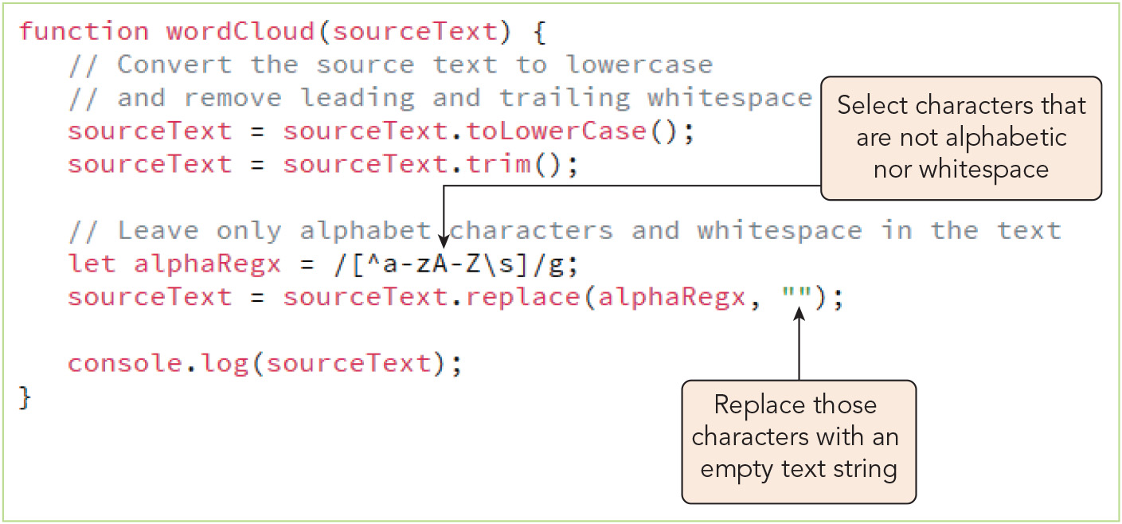
Programming with Regular Expressions (5 of 10)
Figure 7-26 Removing non-alphabetic characters

Slide 28
Programming with Regular Expressions (6 of 10)
Replacing text with regular expressions (continued)
For a word cloud app, stop words must be removed before counting the frequencies of meaningful words
To remove words from a source text:
Create an array of the words that should be removed
Use a for loop to apply the replace() method to the source text using each word in the array as the regular expression pattern to match, replacing them with empty strings

Slide 29
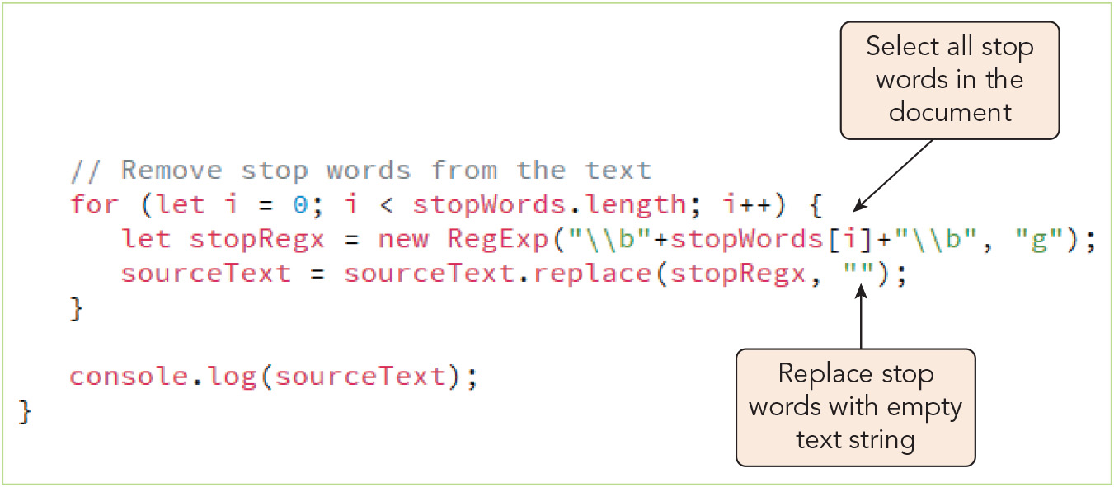
Programming with Regular Expressions (7 of 10)
Figure 7-29 Removing stop words from the source text

Slide 30
Programming with Regular Expressions (8 of 10)
Splitting a text string into an array
Syntax for creating an array of substrings from a string using the match() method: let array = str.match(re)
Sample code to extract words from a string and place them into an array: let words = "with malice towards none".match(/\b\w+\b/g); // words = ["with", "malice", "towards", "none"]
Sample code creating an array of substrings from a string using the split() method: words = "with malice towards none".split(/\s+/g); // words = ["with","malice","towards","none"]
Here, the regular expression serves as the delimiter

Slide 31
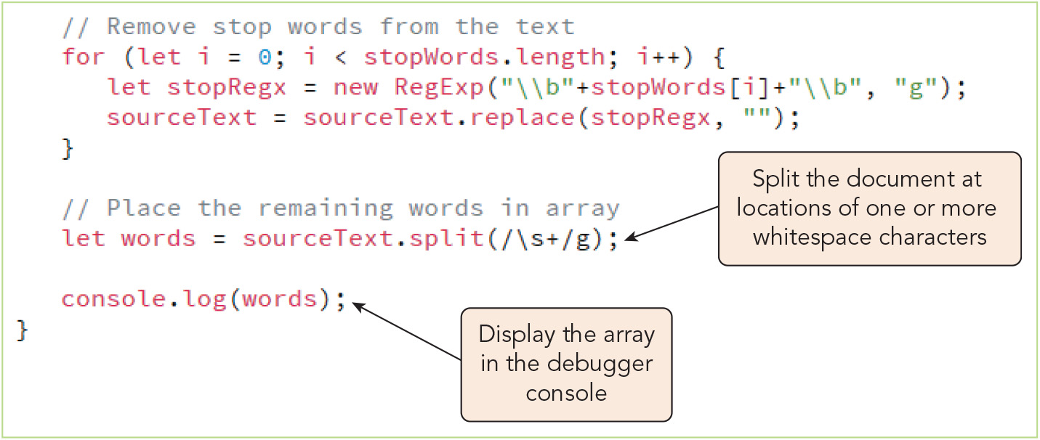
Programming with Regular Expressions (9 of 10)
Figure 7-31 Splitting a text string to an array

Slide 32
Programming with Regular Expressions (10 of 10)
Referencing substring matches
When a method is applied to a regular expression, information about the substrings is stored in a JavaScript RegExp object using properties $1 through $9
$1 property returns first group of matching substrings, $2 the second, etc.
Sample code utilizing $1 and $2 properties to manipulate string data: let names = "Travis Lee, Darius Green, Alisha Draves"; let re = /(\w+)\s(\w+),?/g; let names2 = names.replace(re, '$2, $1; '); // returns "Lee, Travis; Green, Darius; Draves, Alisha"
Balancing readability and efficiency in regular expressions
For custom regular expressions, consider whether readability or compactness is a higher priority
Compact expressions are typically faster to execute, but harder to test and harder for other developers to read and understand

Slide 33
Activity 7.1: Knowledge Check
What will the value of phrase3 be after this code executes? let phrase = "Shiver me timbers!"; let phrase2 = phrase.toUpperCase(); let phrase3 = phrase2.substr(10, 7);
What will the value of phrase2 be after this code executes? let phrase = "Box 222, Birmingham, AL 35210"; let regex = new RegExp("^\d{3,4}$", "g"); let phrase2 = phrase.replace(regex, "?");
Notes:
Instructions:
Use the Knowledge Check questions to periodically pose a question to students during class to gauge how well they can recall the material that was presented.

Slide 34
Activity 7.1: Knowledge Check Answers
What will the value of phrase3 be after this code executes? let phrase = "Shiver me timbers!"; let phrase2 = phrase.toUpperCase(); let phrase3 = phrase2.substr(10, 7); Answer: "TIMBERS"
What will the value of phrase2 be after this code executes? let phrase = "Box 222, Birmingham, AL 35210"; let regex = new RegExp("\b\d{3,4}\b", "g"); let phrase2 = phrase.replace(regex, "?"); Answer: "Box ?, Birmingham, AL 35210"
Notes:
Instructions:
Use the Knowledge Check questions to periodically pose a question to students during class to gauge how well they can recall the material that was presented.

Slide 35
Exploring Array Methods (1 of 10)
Reversing and sorting an array
Sample code using the reverse() method: let cards = ["Ace", "King", "Queen", "Jack"]; cards.reverse(); // returns ["Jack", "Queen", "King", "Ace"]
The sort() method rearranges an array in lexicographical order, e.g.: cards.sort(); // returns ["Ace", "Jack", "King", "Queen"]
When a sorted array of words contains duplicates, you can create a multidimensional array to store pairs of values representing each word and its frequency using an if else block within a for loop
The if branch increases the frequency value by 1 for words already included in the new, multidimensional array
The else branch adds words with a frequency of 1 if they aren't in the new array

Slide 36
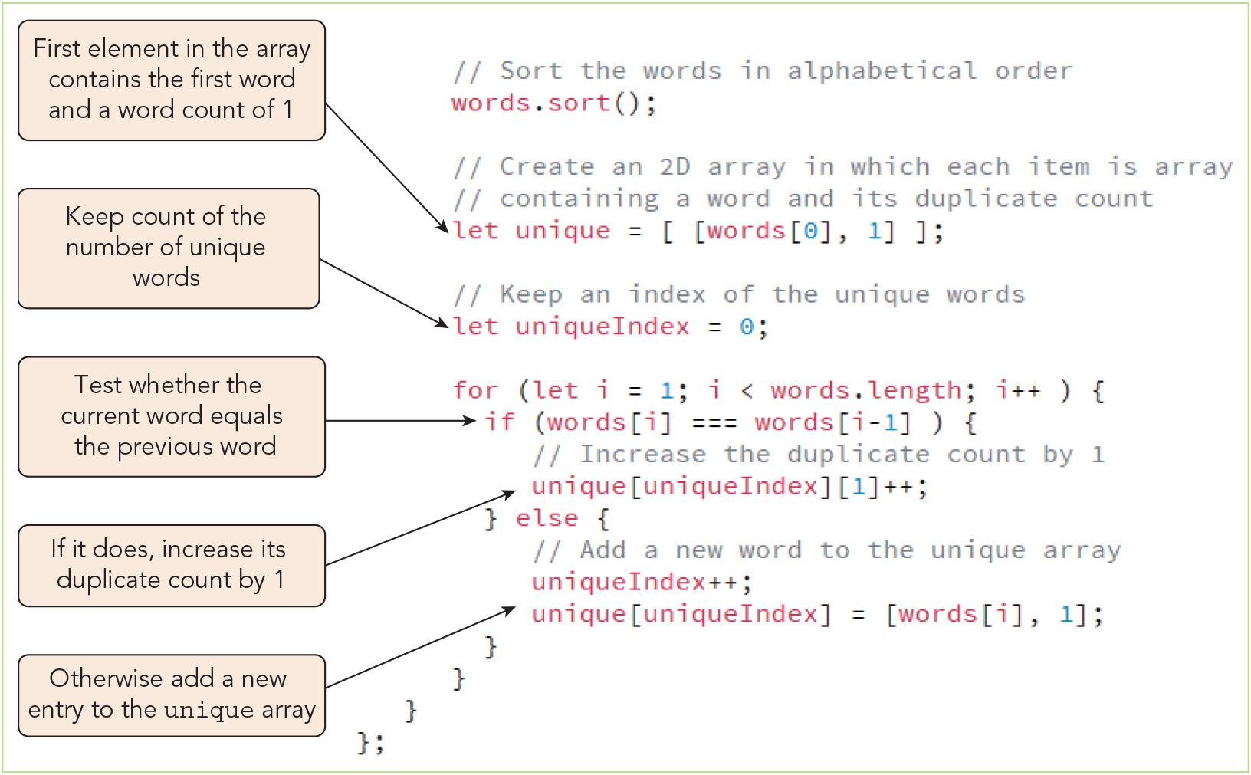
Exploring Array Methods (2 of 10)
Figure 7-36 Code to generate the array of unique words

Slide 37
Exploring Array Methods (3 of 10)
Sorting with a compare function
A compare function must be passed in as an argument to the sort() method to sort an array by numeric value
General syntax for a compare function: function compare(a, b) { return compareValue; }
If compareValue is negative, a is moved before b
If compareValue is positive, a is moved after b
If compareValue is 0, a and b remain where they are

Slide 38
Exploring Array Methods (4 of 10)
Sorting with a compare function (continued)
Compare function that sorts numbers by increasing order of value: function ascending(a, b) { return a – b; }
Compare function that sorts numbers by decreasing order of value: function descending(a, b) { return b – a; }

Slide 39
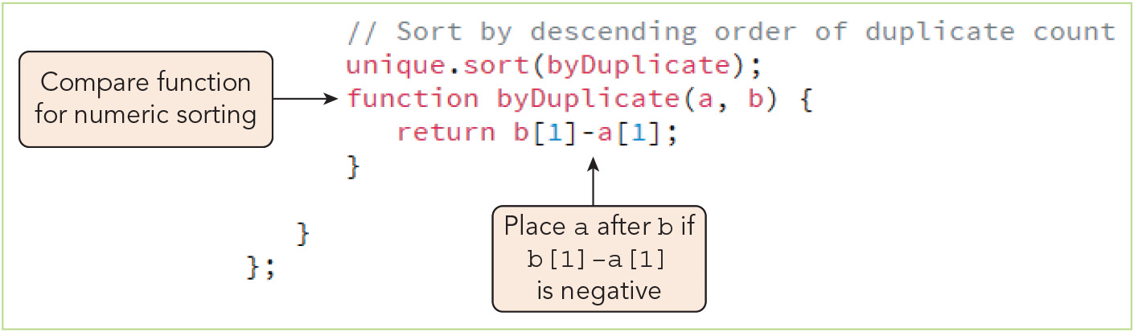
Exploring Array Methods (5 of 10)
Figure 7-38 Using sort() with a compare function

Slide 40
Exploring Array Methods (6 of 10)
Extracting and inserting array items
Syntax for creating a subarray using the slice() method: array.slice(start, stop)
start is the index of the first item for the subarray
stop is the index before which the slice ends
Syntax for modifying a subarray using the splice() method: array.splice(start, size, values)
start is the index of the first item to remove
size is the number of array items to remove
values (optional) is a comma-separated list of values to insert in place of the removed elements

Slide 41
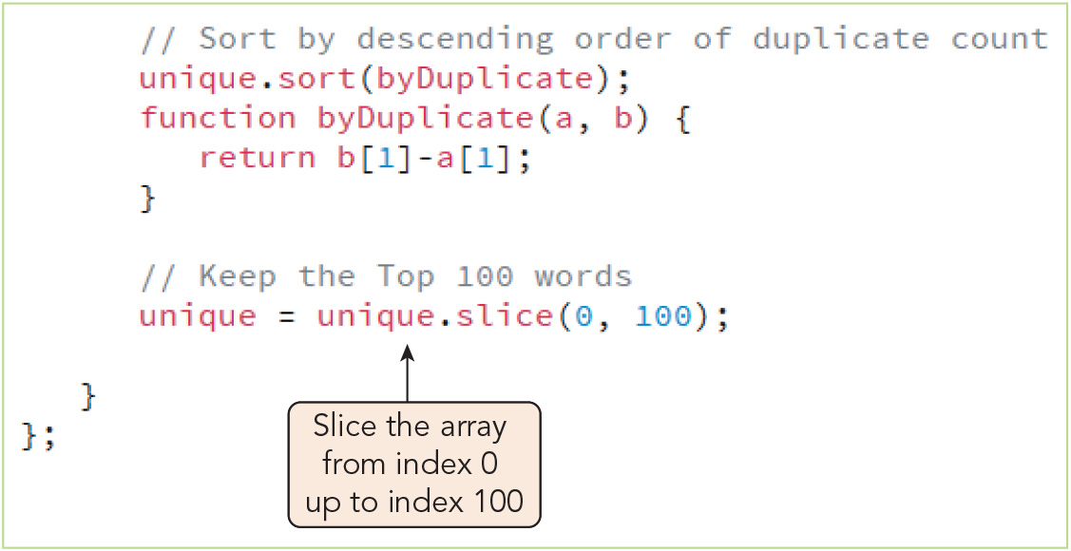
Exploring Array Methods (7 of 10)
Figure 7-40 Slicing an array

Slide 42
Exploring Array Methods (8 of 10)
Using arrays as data stacks
Stack: data structure that employs the last-in-first-out (LIFO) principle, in which the last items added to the stack are the first ones removed
The array.push(values) method appends new items to the end of an array
The array.pop() method removes the last item from the end of an array
Queue: data structure that employs the first-in-first-out (FIFO) principle, in which the first item added is the first item removed
The shift() method removes the first array item
The unshift() method inserts new items at the beginning of an array
To complete the word cloud app project, the frequency count for the word with the highest frequency is used to calculate the font sizes of other words
(Word frequency / top word's frequency) * (font size of top word)

Slide 43
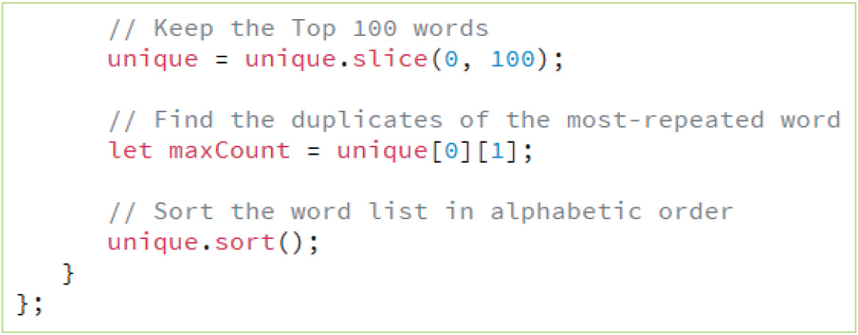
Exploring Array Methods (9 of 10)
Figure 7-42 Determine the count of the most-repeated words

Slide 44
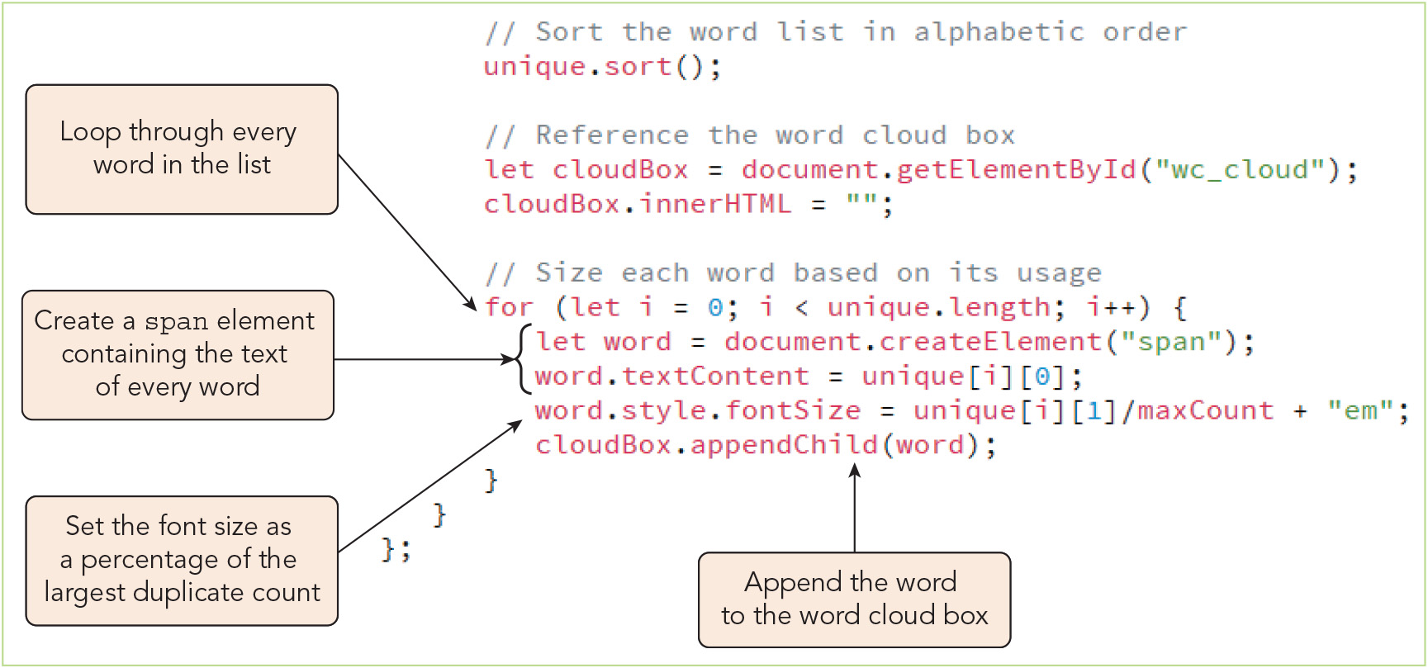
Exploring Array Methods (10 of 10)
Figure 7-43 Sizing the words in the word cloud

Slide 45
Activity 7.2: Think, Pair, and Share
Form pairs/groups of two to four class members.
Your group will write a program to rearrange the sentences in a source text. First, write out an algorithm for your program—that is, list the steps it will need to take, in order, to transform a text string consisting of multiple sentences by rearranging those sentences (leaving them intact). You could choose to rearrange them randomly, reverse them, alphabetize them, etc.
Write a program based on your algorithm, using the string manipulation techniques you learned from Chapter 7.
Notes:
Instructions:
Use the Think, Pair, Share activity to encourage students to solve problems collaboratively and to apply the real-world skill of evaluating, modifying, and debugging code created by another programmer.

Slide 46
Exploring the Math Object (1 of 3)
The Math object
Math object: a built-in JavaScript object used for performing mathematical operations and storing mathematical constants
No constructor; all properties and methods are available without creating it
Many useful methods
Also supports trigonometric functions
Math object properties
General syntax for built-in constants: Math.CONSTANT
Math.PI constant is often used in calculations with built-in trigonometric functions

Slide 47
Exploring the Math Object (2 of 3)
Applying a Math method to an array
The max() or min() method can be used to determine the maximum or minimum value from an array of numbers
Two approaches to using them with arrays:
With the apply() method: Math.max.apply(null, array)
Using the spread operator, e.g.: Math.max(…[3, 8, 2, 4, 6]) // returns 8 Math.min(…[3, 8, 2, 4, 6]) // returns 2
The spread operator spreads out the items within an array into a comma-separated list of values and can be used with any JavaScript method or function that requires such a list; not supported by early editions of many browsers
Can spread string characters into separate characters, too, e.g.: let chars = ["a", …"bcd ", "e"] // returns ["a","b","c","d","e"]

Slide 48
Exploring the Math Object (3 of 3)
Random numbers and random sorting
The Math.random() method returns a random number between 0 and 1
Syntax to return a random value from a different range, where lowest is the lower boundary of the range and size is the size of the range: lowest + size*Math.random()
Sample statement to generate a random integer from 21 to 30: Math.floor(21 + 10*Math.random());
Sample compare function to randomly sort an array when passed in to the sort() method: function randOrder(){ return 0.5 – Math.random(); }

Slide 49
Exploring the Date Object (1 of 2)
Date object: object that stores date and time values
Syntax for its constructor: new Date("month day, year hrs:mins:secs") or new Date(year, month, day, hrs, mins, secs)
If no time value is specified, it is assumed to be 0:0:0 (midnight) for the specified day
Sample statement that stores the current date and time from the system clock: let today = new Date();
Extracting information from dates and times
Dates are stored as numbers (milliseconds since 1-1-1970)
Intervals between dates are expressed as the difference in milliseconds, so you must divide the time difference by 1000*60*60*24 to get the difference in days
Methods for extracting date and time information are available based on the local time, Universal Time Coordinated (UTC) time, and Greenwich Mean Time (GMT)

Slide 50
Exploring the Date Object (2 of 2)
Setting date and time values
Use Date object methods to change the date or time stored within a Date object
Sample code to store a date that is one year after the current date: let date = new Date(); let year = date.getFullYear(); // stores the year date.setFullYear(year + 1); // increases year by 1
Sample expression to set a time value equal to 5 hours, 30 minutes, 15 seconds, and 4 milliseconds: setHours(5, 30, 15, 4)
Writing dates and times for a global marketplace
Format dates and times in the user's local format using the date.toLocaleString() method

Slide 51
Exploring Template Literals (1 of 3)
A template literal encloses the text string within backtick characters (`)
Advantages of template literals over standard text strings:
Can be extended across multiple lines without using the + operator
Characters such as single and double quotes can be placed directly within the string
Whitespace characters including line breaks are preserved as part of the text string
Variables and expressions can be inserted directly within the text string
Adding placeholders to template literals
Syntax for the placeholder: ${placeholder}
Sample use of placeholders: let group1 = "none"; let group2 = "all"; `With malice towards ${group1} and charity for ${group2}` // Returns "With malice towards none and charity for all"

Slide 52
Exploring Template Literals (2 of 3)
Tagging a template literal
Template literals break up the text string into an implicit array of literal substrings between the placeholders
The placeholders themselves form a set of arguments called substitutions
General syntax for a function that tags a template literal: function {literals, …substitutions} commands return value; }
To tag the template literal with the function, place the function name directly before the template literal

Slide 53
Exploring Template Literals (3 of 3)
Tagging a template literal (continued)
Sample function that returns a text string in which each substitution is displayed in uppercase letters, plus the application of this function to a template literal: function highlight(literals, ...substitutions) { let result = ""; for (let i = 0; i < substitutions.length; i++) { result += literals[i]; result += substitutions[i].toUpperCase(); } return result; } highlight`With malice towards ${group1} and charity for ${group2}`; // Returns "With malice towards NONE and charity for ALL"

Slide 54
Activity 7.3: Discussion Questions
What is a regular expression? What are the benefits or advantages of working with regular expressions?
Explain the different methods that can be used to convert between strings and arrays in JavaScript.
Notes:
Instructions:
Use the Discussion activity to encourage group conversation about a related topic of interest.

Slide 55
Self-Assessment
What experience do you have working with regular expressions? How do you feel about regular expressions—do you enjoy writing or interpreting them?
Which string and/or array manipulation techniques you learned in Chapter 7 do you expect to find most useful in your anticipated career? Why?
Describe your experience working with template literals. Do you prefer using them over standard strings enclosed in quote marks in your programs? Why or why not?
Notes:
Instructions:
Use the Self-Assessment question to encourage students to evaluate their progress or goals in the course, as well as determine how they might apply their learning or grow as an individual.

Slide 56
Summary
Now that the lesson has ended, you should have learned to:
Read information from a text file.
Read and write content into a text string.
Interpret the language of regular expressions.
Create a regular expression object and use it in a program.
Sort an array using the sort() method with a compare function.
Work with the properties and methods of the Math object.
Work with the properties and methods of the Date object.
Explore text strings using template literals.
Notes:
Instructions: Reiterate the learning objectives for the lesson. Students should use this information to guide their studies and reinforcement of new concepts.

